Slide 1
Results obtained with our autoencoder
(6 convolutional layers with incremental number of kernels)

Slide 2
Val sopra, Test sotto nel caso senza shuffle di train e val
N.features prima e dopo | Auc | Pr Auc | Precision | Recall | f1 | confusion matrix | Accuracy | classificatore/Selector
16 -> 11 | 0.684 | 0.5085 | 0.5 | 1 | 0.666 | 8 11 0 11 | 0.633 | SVM/MRMR
32 -> 15 | 0.565 | 0.622 | 0.526 | 0.909 | 0.666 | 10 9 1 10 | 0.666 | SVM/LOGISTIC
64 -> 4 | 0.789 | 0.721 | 0.625 | 0.909 | 0.741 | 13 6 1 10 | 0.767 | MLP/LOGISTIC
128 -> 6 | 0.713 | 0.676 | 0.5 | 1 | 0.6 | 8 11 0 11 | 0.633 | XGBOOST/RF
16 -> 11 | 0.5 | 0.34 | 0.285 | 0.5 | 0.3636 | 7 10 4 4 | 0.44 | SVM/MRMR
32 -> 15 | 0.463 | 0.398 | 0.308 | 0.5 | 0.3809 | 8 9 4 4 | 0.48 | SVM/LOGISTIC
64 -> 4 | 0.434 | 0.337 | 0.273 | 0.375 | 0.316 | 9 8 5 3 | 0.48 | MLP/LOGISTIC
128 -> 6 | 0.353 | 0.314 | 0.25 | 0.625 | 0.357 | 2 15 3 5 | 0.28 | XGBOOST/RF

Slide 3
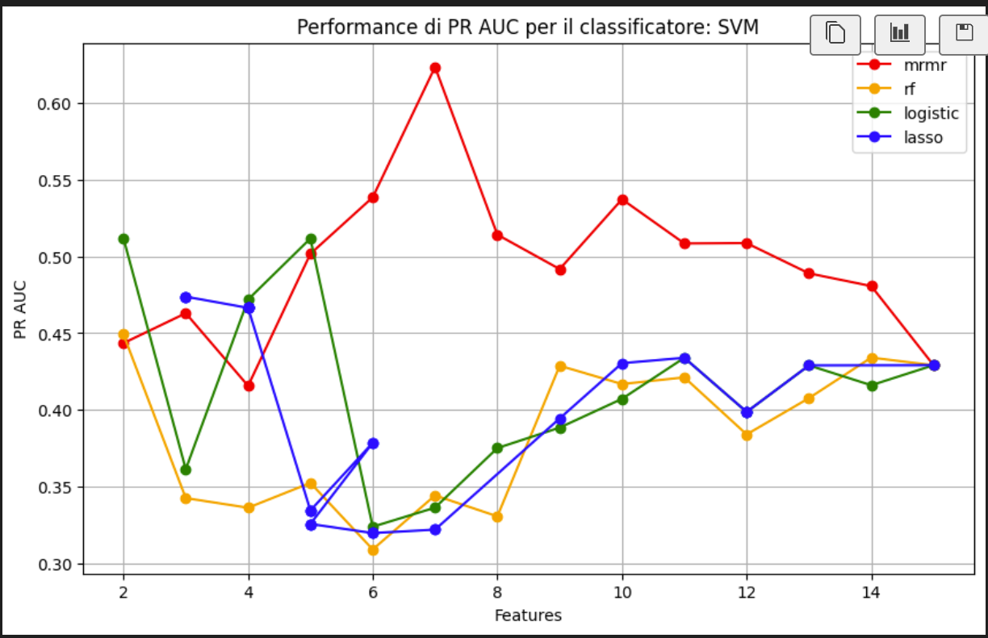
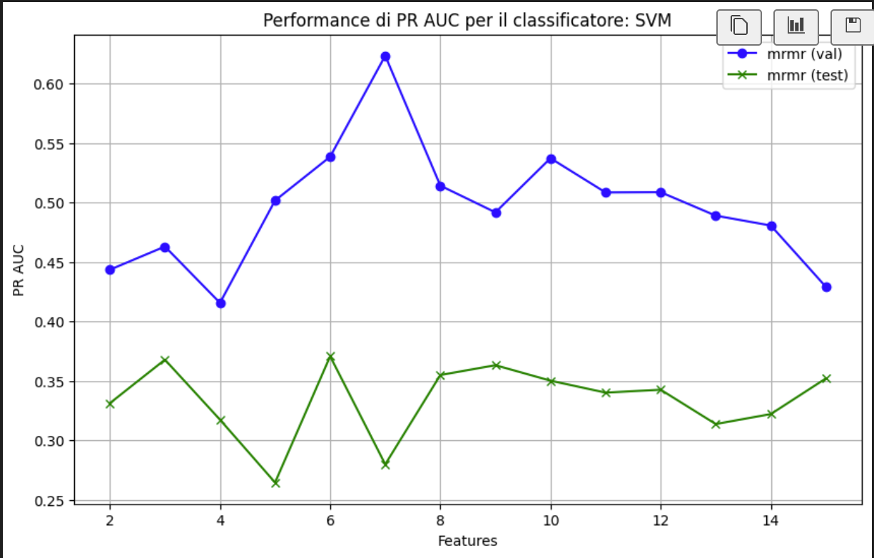
Validation performance of different selector for the best classifier in the 16 case
Validation vs test performance with best selector
F1 = 0.316
Precision = 0.273
Recall = 0.375
Accuracy = 0.48
Num_features= 14
Results obtained using as the training set the full dataset
Confusion:
[ 9 8]
[ 5 3]

Slide 4
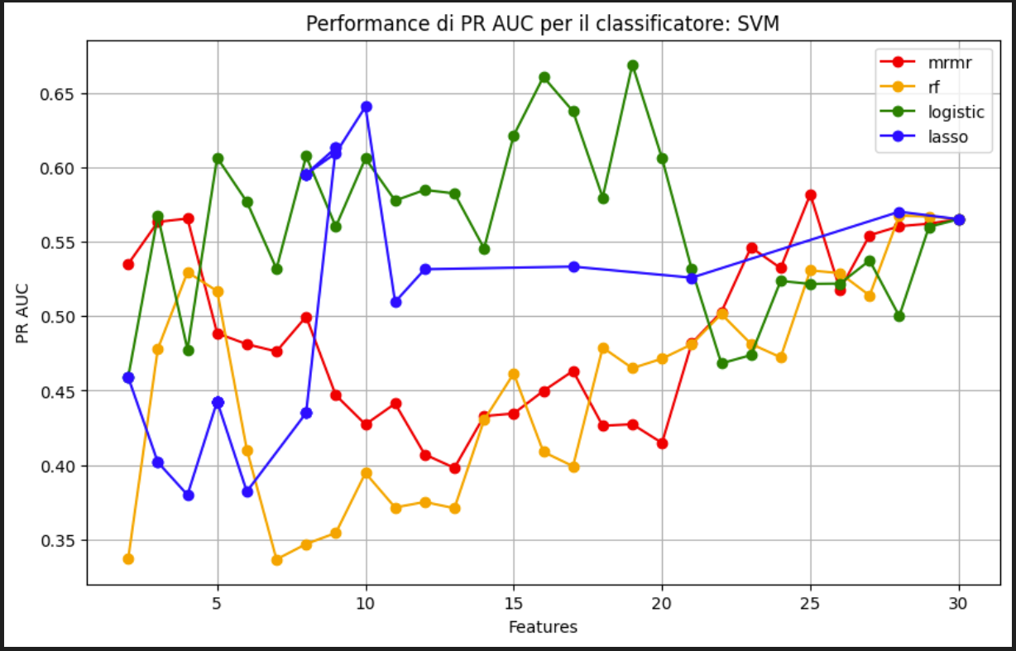
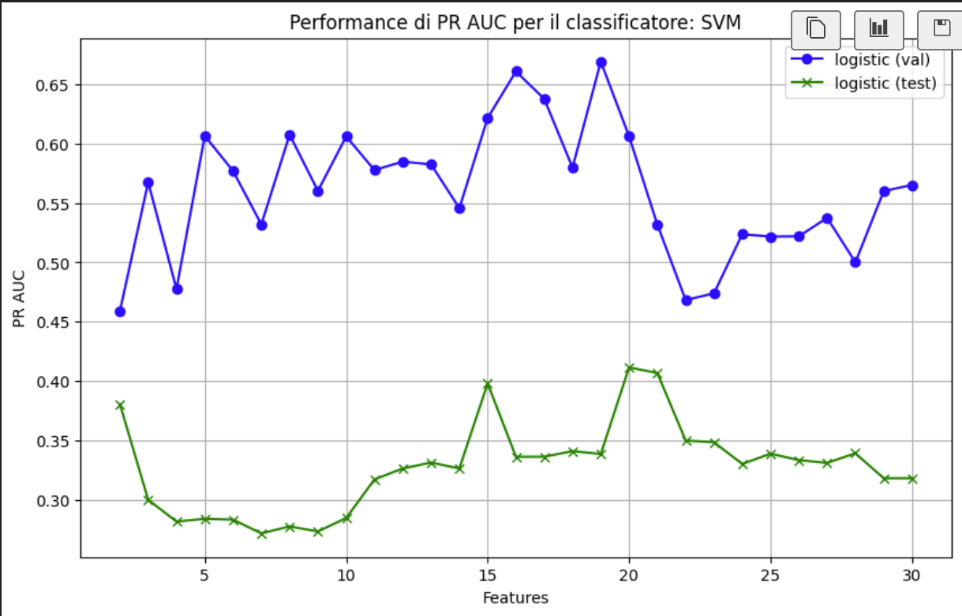
Validation performance of different selector for the best classifier in the 32 case
Validation vs test performance with best selector
F1 = 0.211
Precision = 0.182
Recall = 0.25
Accuracy = 0.4
Num_features= 15
Results on the test set using all the train as dataset
Confusion:
[ 8 9]
[ 6 2]

Slide 5
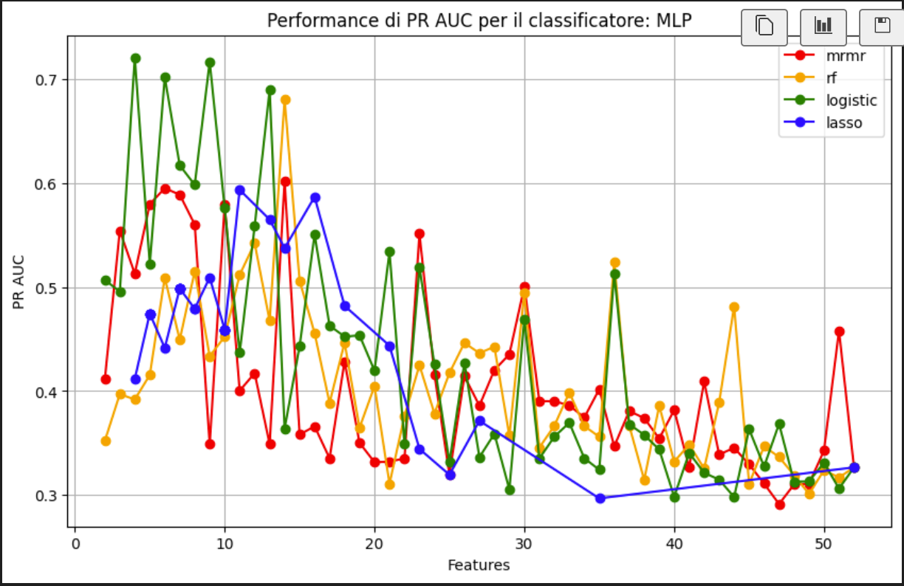
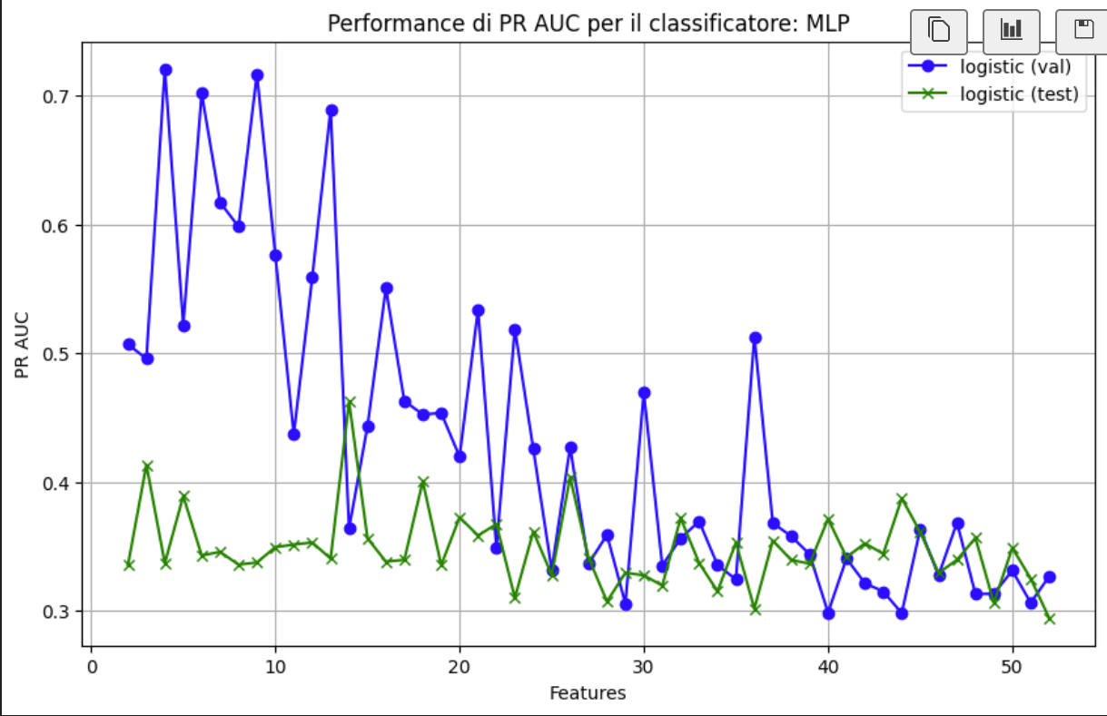
Validation performance of different selector for the best classifier in the 64 case
Validation vs test performance with best selector
F1 = 0.25
Precision = 0.1875
Recall = 0.375
Accuracy = 0.28
Num_features= 4
Results on the test set using all the train as dataset
Confusion:
[ 4 13]
[ 5 3]

Slide 6
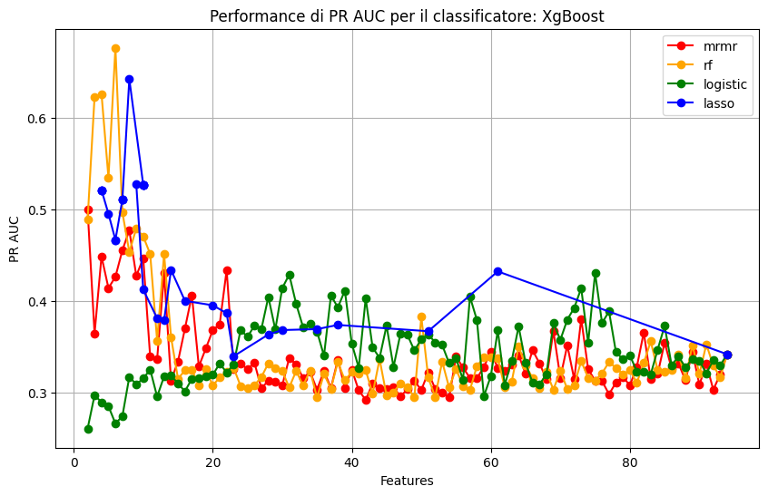
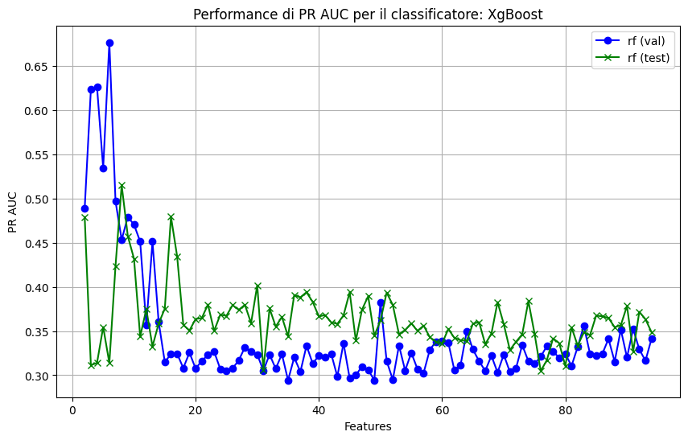
Validation performance of different selector for the best classifier in the 128 case senza Shuffle
Validation vs test performance with best selector
F1 = 0.4826
Precision = 0.333
Recall = 0.875
Accuracy = 0.4
num_features= 6
Results on the test set using all the train as dataset
Confusion Matrix finale:
[ 3 14]
[ 1 7]

Slide 7
Val sopra, Test sotto nel caso shuffle di train e val
N.features prima e dopo | Auc | Pr Auc | Precision | Recall | f1 | confusion matrix | Accuracy | classificatore/Selector
16 -> 13 | 0.69 | 0.589 | 0.75 | 0.857 | 0.8 | 12 4 2 12 | 0.8 | MLP/LOGISTIC
32 -> 5 | 0.857 | 0.846 | 0.8125 | 0.9286 | 0.866 | 13 3 1 13 | 0.866 | SVM/LASSO
64 ->3 | 0.8214 | 0.778 | 0.7 | 1 | 0.8235 | 10 6 0 14 | 0.8 | SVM/LOGISTIC
128 -> 10 | 0.835 | 0.744 | 0.737 | 1 | 0.8484 | 11 5 0 14 | 0.833 | MLP/LOGISTIC
16 -> 13 | 0.330 | 0.262 | 0.222 | 0.25 | 0.2353 | 10 7 6 2 | 0.48 | MLP/LOGISTIC.
32 -> 5 | 0.375 | 0.2775 | 0.3 | 0.375 | 0.333 | 10 7 5 3 | 0.52 | SVM/LASSO
64 -> 3 | 0.5588 | 0.4076 | 0.25 | 0.375 | 0.3 | 8 9 5 3 | 0.44 | SVM/LOGISTIC
128 -> 10 | 0.375 | 0.282 | 0.294 | 0.625 | 0.4 | 5 12 3 5 | 0.4 | MLP/LOGISTIC

Slide 8
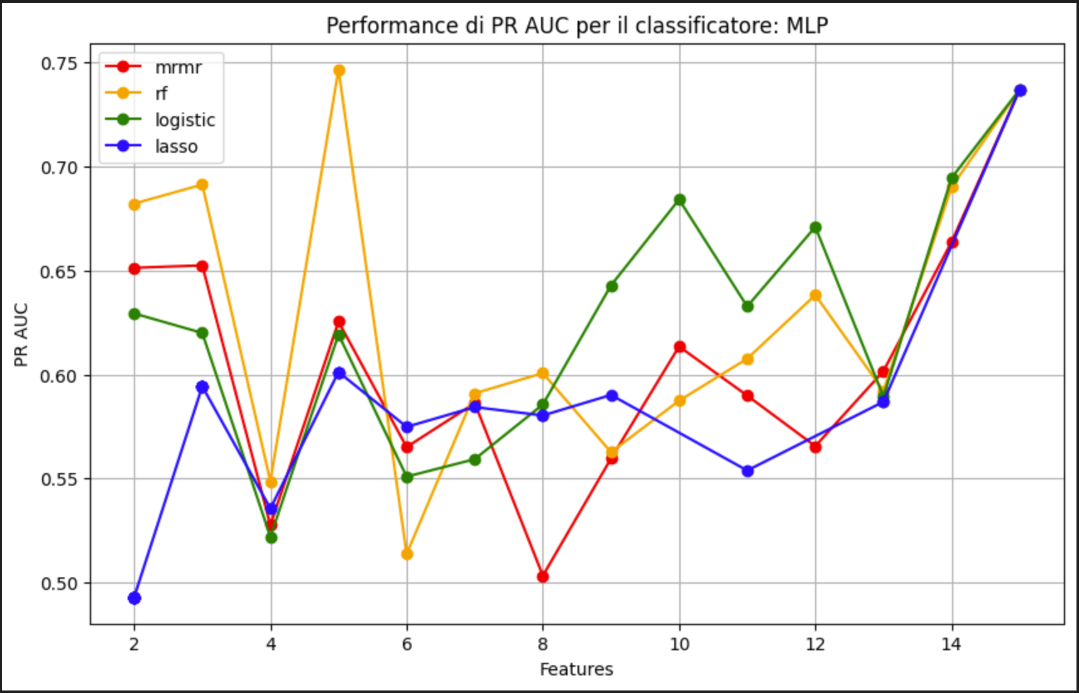
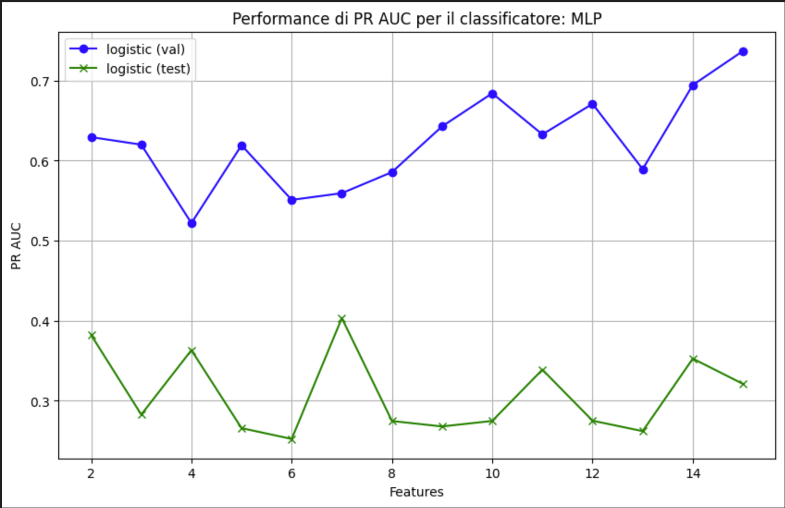
Validation performance of different selector for the best classifier in the 16 case
Validation vs test performance with best selector
F1 = 0.348
Precision = 0.267
Recall = 0.5
Accuracy = 0.4
Num_features= 13
Results on the test set using all the train as dataset
Confusion:
[6 11]
[4 4]

Slide 9
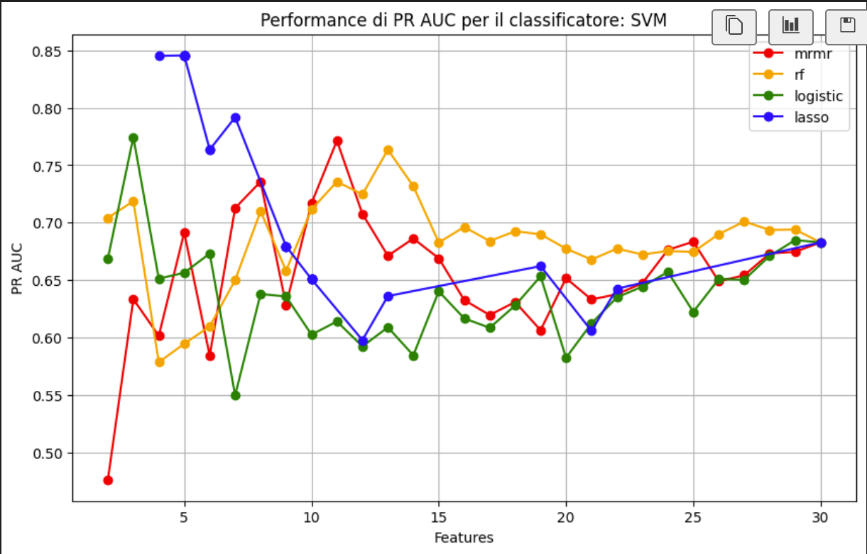
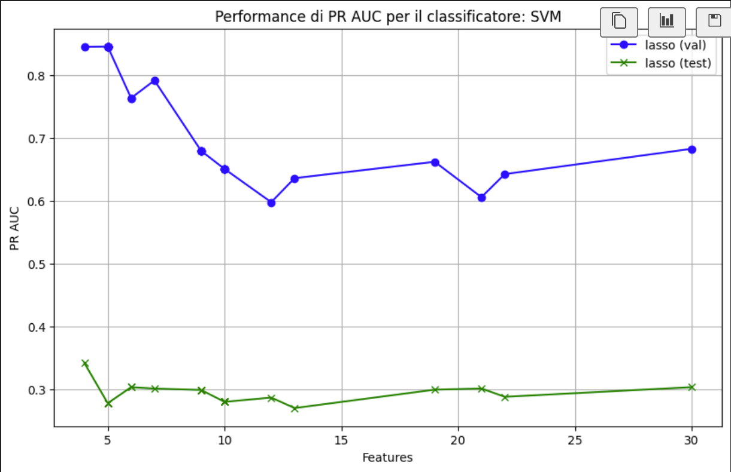
Validation performance of different selector for the best classifier in the 32 case
Validation vs test performance with best selector
F1 = 0.222
Precision = 0.2
Recall = 0.25
Accuracy = 0.44
Num_features= 5
Results on the test set using all the train as dataset
Confusion:
[ 9 8]
[ 6 2]

Slide 10
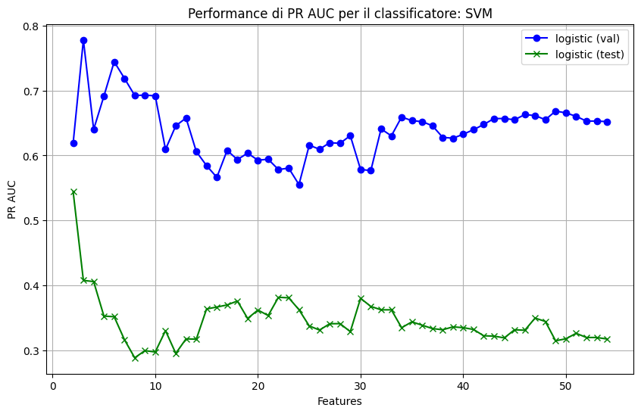
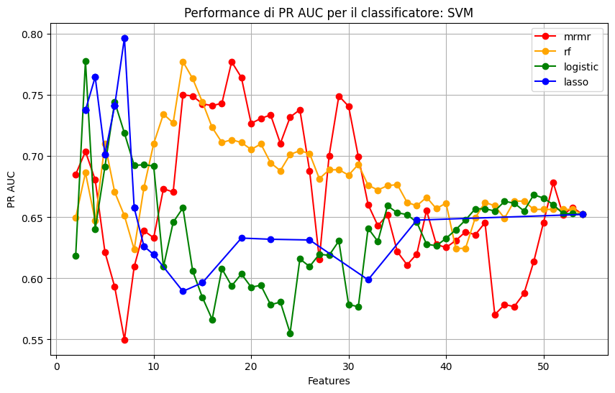
Validation performance of different selector for the best classifier in the 64 case
Validation vs test performance with best selector
F1 = 0.375
Precision = 0.375
Recall = 0.375
Accuracy = 0.6
Num_features= 3
Results on the test set using all the train as dataset
Confusion:
[12 5]
[ 5 3]

Slide 11
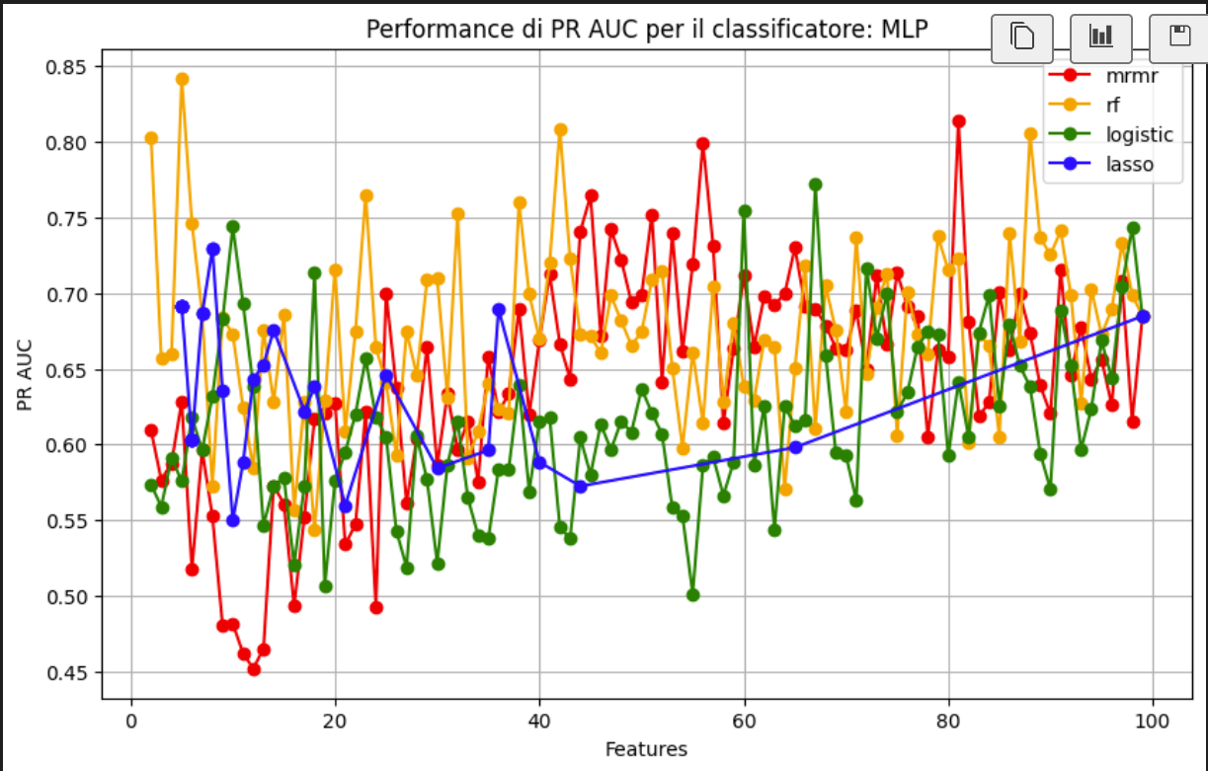
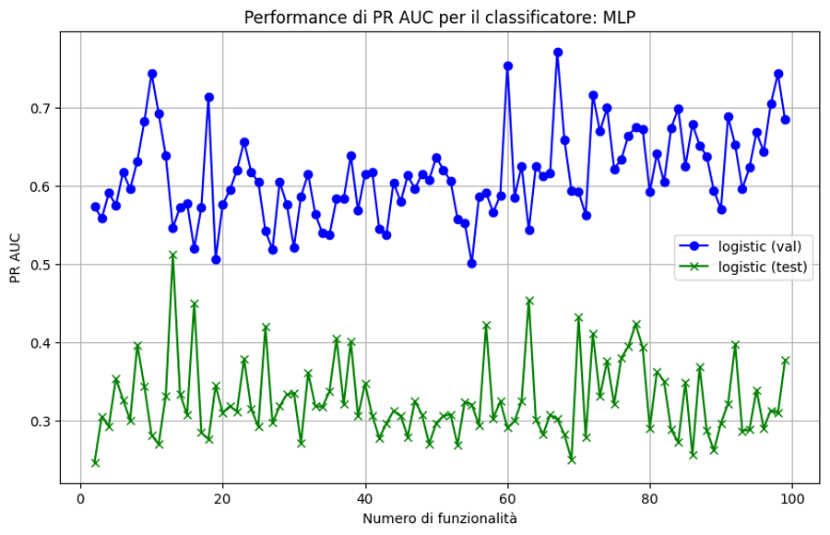
Validation performance of different selectors for the best classifier in the 128 case
Validation vs test performance with best selector
F1 = 0.286
Precision = 0.231
Recall = 0.375
Accuracy = 0.4
num_features= 10
Results on the test set using all the train as dataset
Confusion Matrix finale:
[ 7 10]
[ 5 3]

Slide 12
Different tests

Slide 13
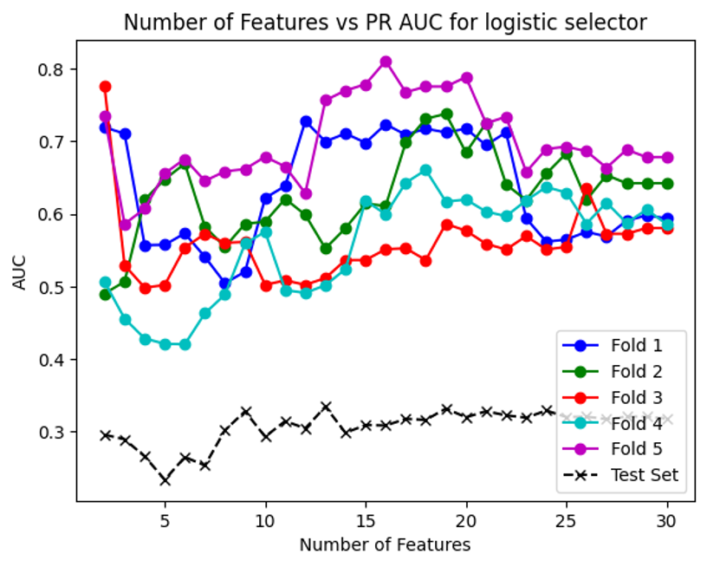
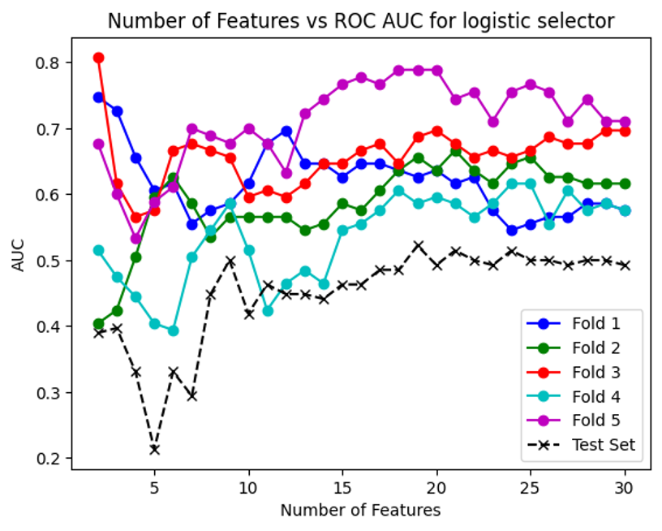
Esempio di stratified cross validation con 5 fold
Results obtained with the best mean parameters Features: 10.8 F1 score: 0.25
best_precision: 0.25
best_recall: 0.25
confusion matrix : [[11 6]
[ 6 2]]
test_accuracy: 0.52
pr_auc: 0.3179414528969482
roc_auc: 0.4926470588235294

Slide 14
Results obtained using a pretrained model(mobilenet)

Slide 15
N.features prima e dopo VALIDATION | Auc | Pr Auc | Precision | Recall | f1 | confusion matrix | Accuracy | classificatore/Selector
32 -> 5 | 0.857 | 0.846 | 0.812 | 0.929 | 0.866 | 13 3 1 13 | 0.866 | SVM/Lasso
64 ->16 | 0.728 | 0.63 | 0.666 | 1 | 0.8 | 9 7 0 14 | 0.766 | MLP/ RandomForest
64 -> 5 No Shuffle | 0.742 | 0.537 | 0.692 | 0.818 | 0.75 | 15 4 2 9 | 0.8 | RandomForest/RandomForest
N.features prima e dopo TEST | Auc | Pr Auc | Precision | Recall | f1 | confusion matrix | Accuracy | classificatore/Selector
32 -> 5 | 0.375 | 0.277 | 0.3 | 0.375 | 0.33 | 10 7 5 3 | 0.52 | SVM/Lasso
64 -> 16 | 0.618 | 0.4 | 0.357 | 0.625 | 0.45 | 8 9 3 5 | 0.52 | MLP/ RandomForest
64 -> 5 No Shuffle | 0.463 | 0.328 | 0.384 | 0.625 | 0.476 | 9 8 3 5 | 0.56 | RandomForest/RandomForest

Slide 16
MOBILENET
32 features solo shuffle

Slide 17
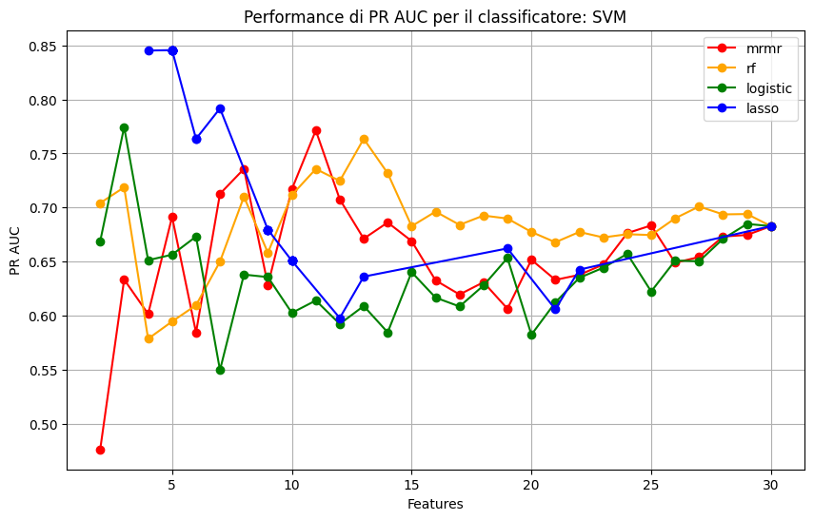
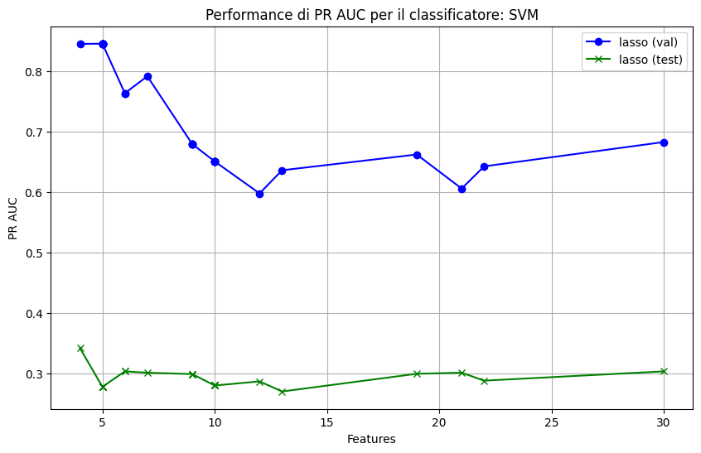
Validation performance of different selectors for the best classifier in the 32 case of Mobilenet with Shuffle
Validation vs test performance with best selector
F1 score finale: 0.5384615384615384
Precision finale: 0.3888888888888889
Recall finale: 0.875
Confusion Matrix finale:
[[ 6 11]
[ 1 7]]
Accuracy finale: 0.52
features: [ 6 7 13 17 27] e sono 5
Results on the test set using all the train as dataset

Slide 18
Mobilenet
64 features senza Shuffle

Slide 19
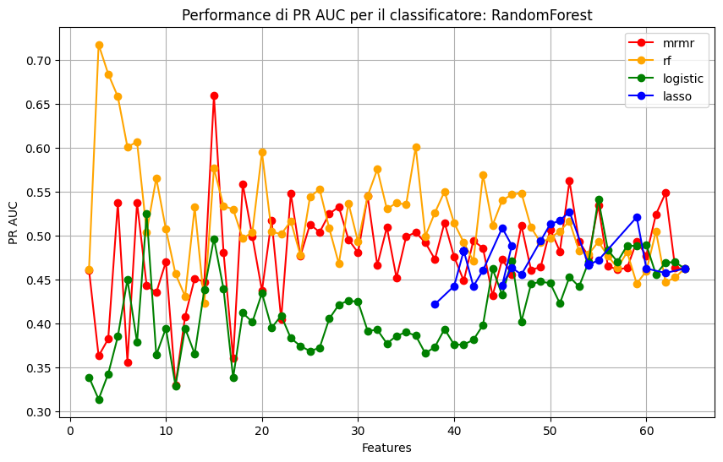
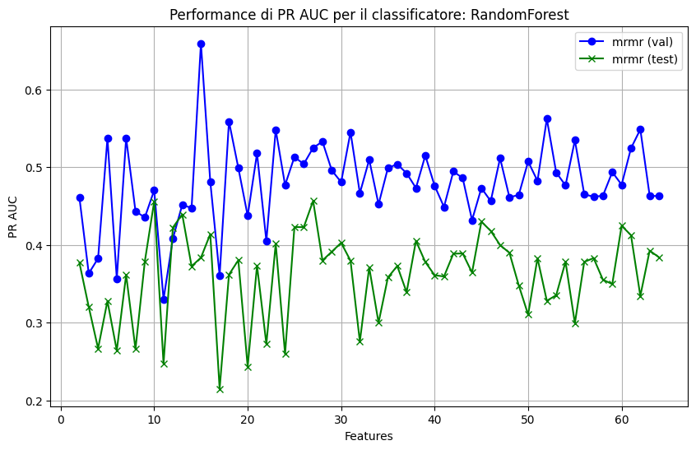
Validation performance of different selector for the best classifier in the 64 case of Mobilenet without Shuffle
Validation vs test performance with best selector
F1 score finale: 0.4
Precision finale: 0.3333333333333333
Recall finale: 0.5
Confusion Matrix finale:
[[9 8]
[4 4]]
Accuracy finale: 0.52
threshold: 0.5
features: [42, 10, 57, 2, 21] e sono 5
Results on the test set using all the train as dataset

Slide 20
MOBILENET
64 features con Shuffle

Slide 21
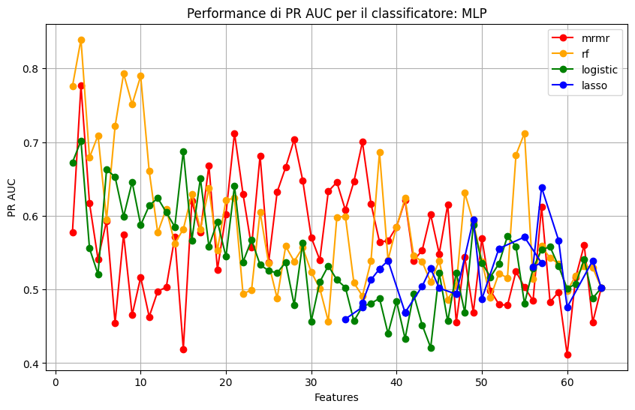
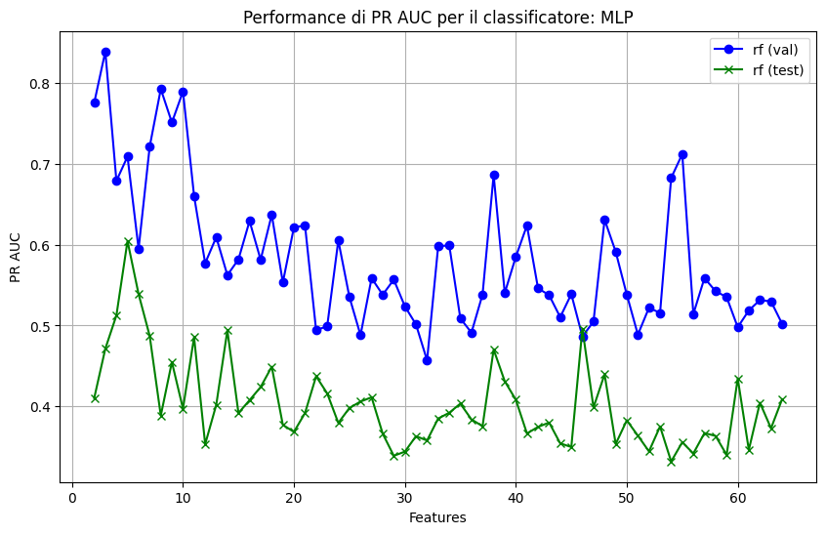
Validation performance of different selectors for the best classifier in the 64 case of Mobilenet with Shuffle
Validation vs test performance with best selector
F1 score finale: 0.5
Precision finale: 0.4166666666666667
Recall finale: 0.625
Confusion Matrix finale:
[[10 7]
[ 3 5]]
Accuracy finale: 0.6
features: 16
Results on the test set using all the train as dataset

Slide 22
Divisione autoencoder: 0,2 validation e 0,2 test
2517 train aumentati a 15102
787 validation
630 Test

Slide 23
Comparing similarity indexes for different autoencoders
Autoencoder | Mean SSIM | Mean SSIM Mask | Mean Cosine Similarity
16 | 0.9213 | 0.5995 | 0.8635
32 | 0.9431 | 0.7126 | 0.9160
64 | 0.9454 | 0.7239 | 0.9056
128 | 0.9403 | 0.6987 | 0.8989
Mobilenet 32 | 0.877 |  | 0.738
Mobilenet 64 | 0.88 |  | 0.742

Slide 24
Comparing similarity indexes for different autoencoders
Autoencoder | Mean SSIM (sfondo nero) | Mean SSIM Mask (sfondo nero) | Mean Cosine Similarity (sfondo nero) | Mean SSIM (originale)
16 | 0.9213 | 0.5995 | 0.8635 | Non testato
32 | 0.9431 | 0.7126 | 0.9160
64 | 0.9454 | 0.7239 | 0.9056
128 | 0.9403 | 0.6987 | 0.8989 | 0.1913

Slide 25
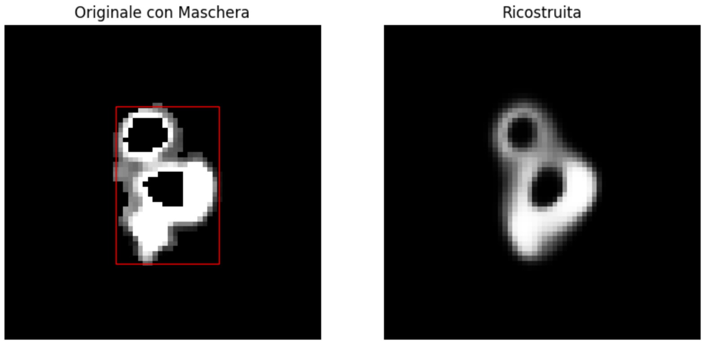
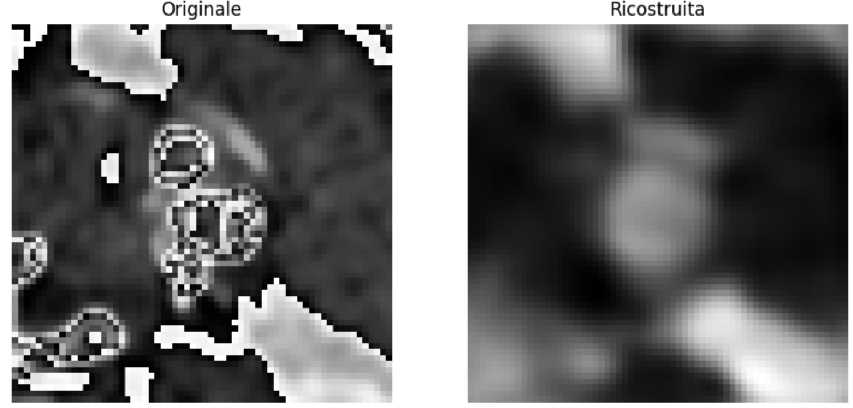
Esempio di maschera per ssim
Esempio di immagine originale (le due immagini sopra e sotto sono la stessa placca)

Slide 26
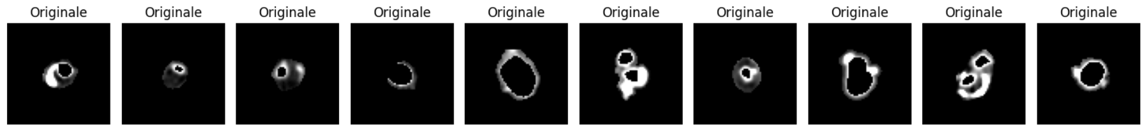
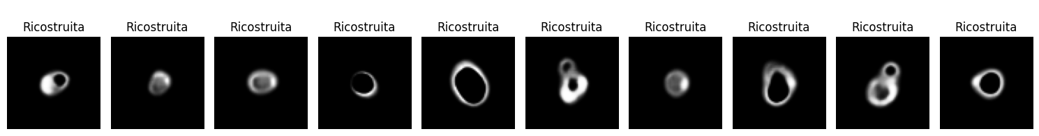
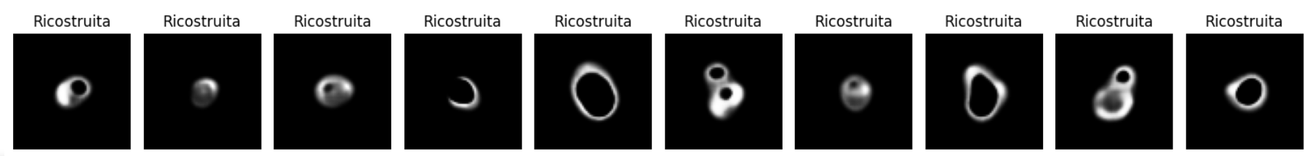
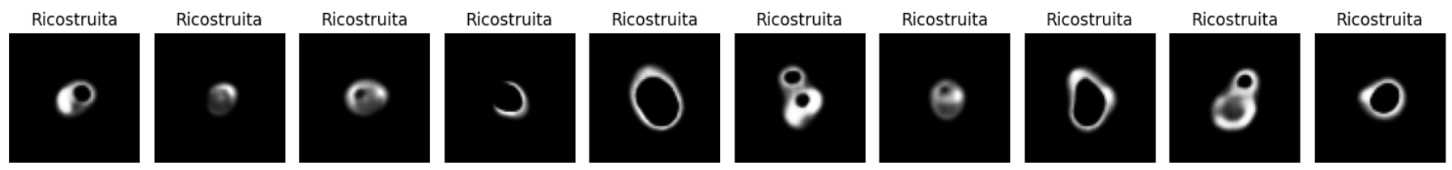
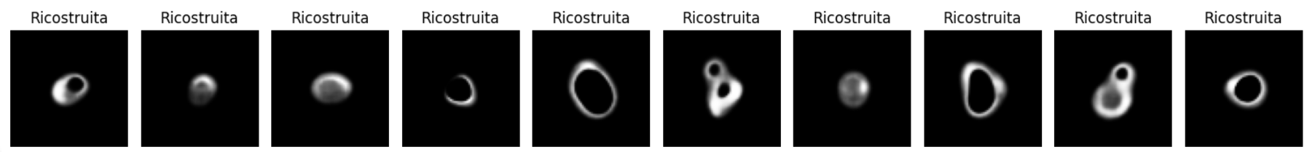
16
32
64
128

Slide 27
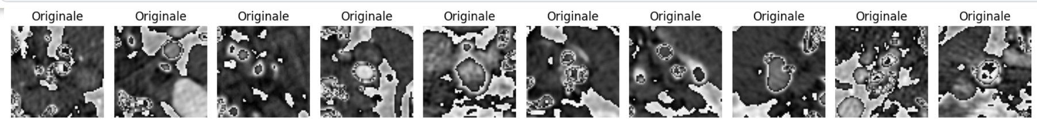
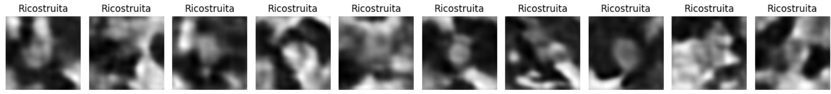

Slide 28
Risultati ottenuti facendo prima feature correlation (0.85),
poi mantenendo le features con p-value inferiore a 0.1 (ipotesi di significatività relativa al gruppo 0 e 1),
poi si confrontano i 5 classifiers (SVM, Logistic, MLP, RandomForerest, XgBoost) a cui i applica feature selection (RandomForest, Logistic, mrmr, lasso e p_value (applicata partendo dalla sola feature più significativa fino a tutte)
69 pazienti train set
30 nel validation set
25 nel test set

Slide 29
Val sopra, Test sotto nel caso shuffle di train e val 0.3
N.features prima e dopo | Auc | Pr Auc | Precision | Recall | f1 | confusion matrix | Accuracy | classificatore/Selector | mode | N-features selected by p_value (0.1)
32 -> 4 | 0.777 | 0.731 | 0.737 | 1 | 0.848 | 11 5 0 14 | 0.833 | XgBoost/Logiatic | majority voting | 12
64 -> 19 | 0.741 | 0.6997 | 0.666 | 1 | 0.8 | 9 7 0 14 | 0.766 | MLP/p_value | majority voting | 31
128 -> 7 | 0.817 | 0.767 | 0.8235 | 1 | 0.903 | 13 3 0 14 | 0.9 | Logistic/RandomForest | majority voting | 43
32 -> 4 | 0.471 | 0.34 | 0.333 | 0.625 | 0.435 | 7 10 3 5 | 0.48 | XgBoost/Logistic | majority voting | 12
64 -> 19 | 0.392 | 0.28 | 0.294 | 0.625 | 0.4 | 5 12 3 5 | 0.4 | MLP/p_value | majority voting | 31
128 -> 7 | 0.2941 | 0.2564 | 0.266 | 0.5 | 0.3478 | 6 11 4 4 | 0.4 | Logistic/RandomForest | majority voting | 43

Slide 30
training sul set di test con il dataset intero
N.features prima e dopo | Precision | Recall | f1 | confusion matrix | Accuracy | classificatore/Selector | mode
32 -> 4 | 0.25 | 0.5 | 0.333 | 5 12 4 4 | 0.36 | XgBoost/Logistic | majority voting
64 -> 19 | 0.357 | 0.625 | 0.4545 | 8 9 3 5 | 0.52 | MLP/p_value | majority voting
128 -> 7 | 0.214 | 0.375 | 0.2727 | 6 11 5 3 | 0.36 | Logistic/RandomForest | majority voting

Slide 31
Val sopra, Test sotto nel caso NON shuffle di train e val 0.3
N.features prima e dopo | Auc | Pr Auc | Precision | Recall | f1 | confusion matrix | Accuracy | classificatore/Selector | mode | N-features selected by p_value (0.1)
32 -> 15 | 0.55 | 0.3855 | 0.55 | 1 | 0.71 | 10 9 0 11 | 0.7 | MLP/Logistic | majority voting | 19
64 -> 21 | 0.445 | 0.4 | 0.478 | 1 | 0.647 | 7 12 0 11 | 0.6 | MLP/RandomForest | majority voting | 30
128 -> 8 | 0.77 | 0.63 | 0.588 | 0.909 | 0.714 | 12 7 1 10 | 0.733 | MLP/p_value | mean | 48
32 -> 15 | 0.507 | 0.338 | 0.2727 | 0.375 | 0.3158 | 9 8 5 3 | 0.48 | MLP/Logistic | majority voting | 19
64 -> 21 | 0.44 | 0.32 | 0.286 | 0.5 | 0.363 | 7 10 4 4 | 0.44 | MLP/RandomForest | majority voting | 30
128 -> 8 | 0.338 | 0.27 | 0.333 | 0.5 | 0.4 | 9 8 4 4 | 0.4 | MLP/p_value | mean | 48

Slide 32
training sul set di test con il dataset intero
N.features prima e dopo | Precision | Recall | f1 | confusion matrix | Accuracy | classificatore/Selector | mode
32 -> 15 | 0.277 | 0.625 | 0.3846 | 4 13 3 5 | 0.36 | MLP/Logistic | majority voting
64 -> 21 | 0.4 | 0.1 | 0.571 | 5 12 0 8 | 0.52 | MLP/RandomForest | majority voting
128 -> 8 | 0.266 | 0.5 | 0.3478 | 6 11 4 4 | 0.4 | MLP/p-value | mean

Slide 33
Val sopra, Test sotto nel caso shuffle di train e val 0.5
N.features prima e dopo | Auc | Pr Auc | Precision | Recall | f1 | confusion matrix | Accuracy | classificatore/Selector | mode | N-features selected by p_value (0.1)
32 -> 9 | 0.714 | 0.593 | 0.666 | 1 | 0.8 | 9 7 0 14 | 0.766 | RandomForest/mrmr | mean | 10
64 -> 6 | 0.7678 | 0.699 | 0.6842 | 0.9286 | 0.7878 | 10 6 1 13 | 0.766 | MLP/mrmr | majority voting | 23
128 -> 13 | 0.8527 | 0.7458 | 0.7368 | 1 | 0.8484 | 11 5 0 14 | 0.8333 | MLP/mrmr | mean | 44
32 -> 9 | 0.4853 | 0.3144 | 0.375 | 0.75 | 0.5 | 7 10 2 6 | 0.52 | RandomForest/mrmr | mean | 10
64 -> 6 | 0.4044 | 0.2933 | 0.222 | 0.25 | 0.235 | 10 7 6 2 | 0.48 | MLP/mrmr | majority voting | 23
128 -> 13 | 0.4412 | 0.2986 | 0.333 | 0.625 | 0.4348 | 7 10 3 5 | 0.48 | MLP/mrmr | mean | 44

Slide 34
training sul set di test con il dataset intero
N.features prima e dopo | Precision | Recall | f1 | confusion matrix | Accuracy | classificatore/Selector | mode
32 -> 9 | 0.3125 | 0.625 | 0.4166 | 6 11 3 5 | 0.44 | RandomForest/mrmr | mean
64 -> 6 | 0.4166 | 0.625 | 0.5 | 10 7 3 5 | 0.6 | MLP/mrmr | majority voting
128 -> 13 | 0.2149 | 0.375 | 0.2727 | 6 11 5 3 | 0.36 | MLP/mrmr | mean

Slide 35
Val sopra, Test sotto nel caso NON shuffle di train e val 0.5
N.features prima e dopo | Auc | Pr Auc | Precision | Recall | f1 | confusion matrix | Accuracy | classificatore/Selector | mode | N-features selected by p_value
32 -> 15 | 0.5454 | 0.398 | 0.5 | 0.909 | 0.645 | 9 10 1 10 | 0.633 | MLP/p_value | majority voting | 20
64 -> 2 | 0.6124 | 0.5519 | 0.4583 | 1 | 0.6286 | 6 13 0 11 | 0.566 | XgBoost/p_value | mean | 27
128 -> 7 | 0.7655 | 0.6061 | 0.6111 | 1 | 0.7586 | 12 7 1 11 | 0.7666 | XgBoost/mrmr | mean | 57
32 -> 15 | 0.4485 | 0. 3228 | 0.3077 | 0.5 | 0.3809 | 8 9 4 4 | 0.48 | MLP/p_value | majority voting | 20
64 -> 2 | 0.3676 | 0.3777 | 0.25 | 0.625 | 0.3571 | 2 15 3 5 | 0.28 | XgBoost/p_value | mean | 27
128 -> 7 | 0.1985 | 0.2328 | 0.1333 | 0.25 | 0.1739 | 4 13 6 2 | 0.24 | XgBoost/mrmr | mean | 57

Slide 36
training sul set di test con il dataset intero
N.features prima e dopo | Precision | Recall | f1 | confusion matrix | Accuracy | classificatore/Selector | mode
32 -> 15 | 0.2308 | 0.375 | 0.2857 | 7 10 5 3 | 0.4 | MLP/p_value | majority voting
64 ->2 | 0.32 | 1 | 0.4848 | 0 17 0 8 | 0.32 | XgBoost/p_valuet | mean
128 -> 7 | 0.1818 | 0.25 | 0.2105 | 8 9 6 2 | 0.4 | XgBoost/mrmr | mean

Slide 37
Val sopra, Test sotto nel caso shuffle di train e val 0.7
N.features prima e dopo | Auc | Pr Auc | Precision | Recall | f1 | confusion matrix | Accuracy | classificatore/Selector | mode | N-features selected by p_value (0.1)
32 -> 3 | 0.7410 | 0.6146 | 0.823 | 1 | 0.9032 | 13 3 0 14 | 0.9 | MLP/Logiatic | majority voting | 11
64 -> 14 | 0.7321 | 0.7 | 0.722 | 0.9286 | 0.8125 | 11 5 1 13 | 0.8 | XgBoost/p_value | majority voting | 14
128 -> 48 | 0.933 | 0.9121 | 0.8235 | 1 | 0.9032 | 13 3 0 14 | 0.9 | MLP/Logistic | mean | 55
32 -> 3 | 0.6570 | 0.4332 | 0.3571 | 0.625 | 0.4545 | 8 9 3 5 | 0.52 | MLP/Logiatic | majority voting | 11
64 -> 14 | 0.5662 | 0.3716 | 0.333 | 0.75 | 0.4615 | 5 12 2 6 | 0.44 | XgBoost/p_value | majority voting | 14
128 -> 48 | 0.5 | 0.3244 | 0.3077 | 0.5 | 0.3809 | 8 9 4 4 | 0.48 | MLP/Logistic | mean | 55

Slide 38
training sul set di test con il dataset intero
N.features prima e dopo | Precision | Recall | f1 | confusion matrix | Accuracy | classificatore/Selector | mode
32 ->3 | 0.32 | 0.1 | 0.4848 | 8 9 3 5 | 0.32 | MLP/Logiatic | majority voting
64 -> | 0.277 | 0.625 | 0.3846 | 4 13 3 5 | 0.36 | XgBoost/p_value | majority voting
128 -> 48 | 0.222 | 0.25 | 0.2353 | 10 7 6 2 | 0.48 | MLP/Logistic | mean

Slide 39
Val sopra, Test sotto nel caso NON shuffle di train e val 0.7
N.features prima e dopo | Auc | Pr Auc | Precision | Recall | f1 | confusion matrix | Accuracy | classificatore/Selector | mode | N-features selected by p_value (0.1)
32 -> 9 | 0.775 | 0.721 | 0.555 | 0.909 | 0.689 | 11 8 1 10 | 0.7 | MLP/mrmr | majority voting | 18
64 -> 3 | 0.6316 | 0.514 | 0.4583 | 1 | 0.6286 | 6 13 0 11 | 0.566 | RandomForest/mrmr | mean | 19
128 -> 6 | 0.6363 | 0.4888 | 0.55 | 1 | 0.7097 | 10 9 0 11 | 0.7 | SVM/mrmr | majority voting | 53
32 -> 9 | 0.4338 | 0.2996 | 0.3333 | 0.5 | 0.4 | 9 8 4 4 | 0.52 | MLP/mrmr | majority voting | 18
64 -> 3 | 0.3897 | 0.2813 | 0.375 | 0.75 | 0.5 | 7 10 2 6 | 0.52 | RandomForest/mrmr | mean | 19
128 -> 6 | 0.2647 | 0.2447 | 0.2 | 0.375 | 0.2609 | 5 12 5 3 | 0.32 | SVM/mrmr | majority voting | 53

Slide 40
training sul set di test con il dataset intero
N.features prima e dopo | Precision | Recall | f1 | confusion matrix | Accuracy | classificatore/Selector | mode
32 -> 9 | 0.25 | 0.375 | 0.3 | 8 9 5 3 | 0.44 | MLP/mrmr | majority voting
64 -> 3 | 0.3888 | 0.875 | 0.5384 | 6 11 1 7 | 0.52 | RandomForest/mrmr | mean
128 -> 6 | 0.3888 | 0.875 | 0.5385 | 6 11 1 7 | 0.52 | SVM/mrmr | majority voting

Slide 41
CONCLUSIONI
Avere 128 features non corrisponde a un indice di similarità migliore. Anche partendo da 128 features, i migliori selector se selezionano sempre poche.
il selector Lasso non viene mai preso come migliore

